Slide 1
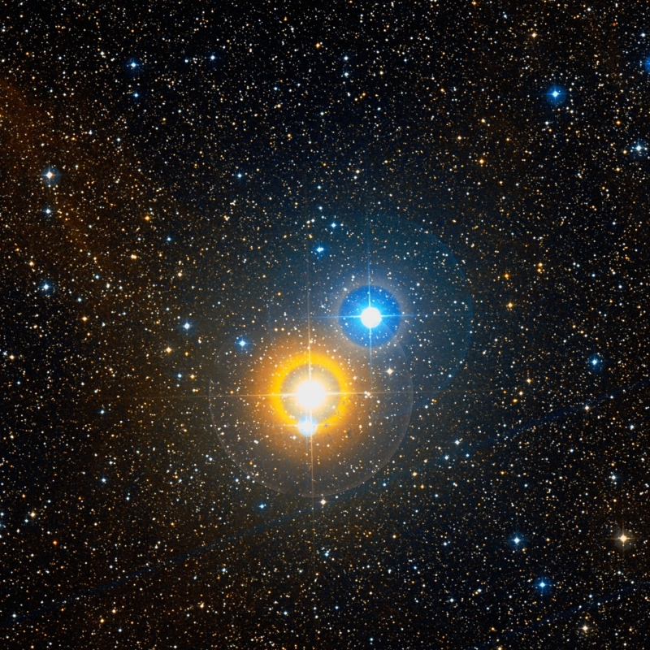
Observing Eclipsing Binary Stars
An ILE By: Nathan Sunbury

Slide 2
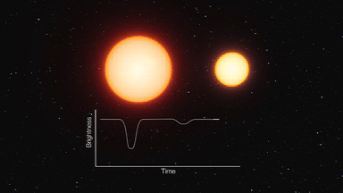
Background

Slide 3
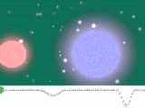
Why Observe Variable Stars?
Most star systems binary
Learn about stellar evolution
Benefit scientists doing research

Slide 4
Algol

